Slide 1
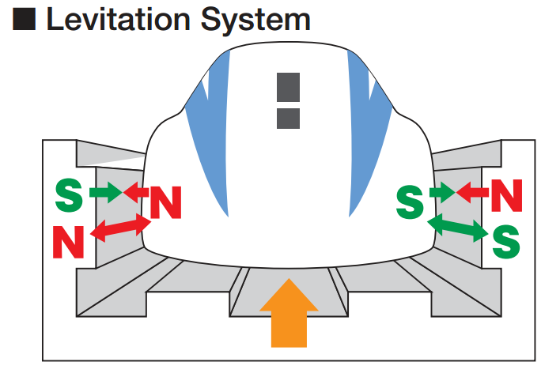
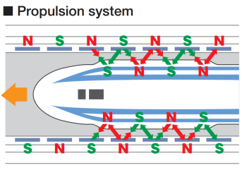
FAN BASED ON MAGNETIC LEVITATION CONCEPT (MAGLEV MOTOR)
WORKING PRINCIPLE: MAGNETIC LEVITATION
Magnetic levitation, maglev, or magnetic suspension is a method by which an object is suspended with no support other than magnetic fields. Magnetic force is used to counteract the effects of the gravitational acceleration and any other accelerations.
The two primary issues involved in magnetic levitation are lifting forces: providing an upward force sufficient to counteract gravity, and stability: ensuring that the system does not spontaneously slide or flip into a configuration where the lift is neutralized.

Slide 2
Why Magnetic Levitation?
Fans created using MagLev motors can produce upto 1000 rpm while conventional electric fans produce 350-400 rpm
Losses due to induction, friction, and iron losses will be low, which is the main disadvantage of conventional fans
Working parts are independent of controlling circuit

Slide 3
SOCIAL RELEVANCE: A COMPARISON WITH EXISTING ELECTRICAL FANS
LESS FRICTION, THUS HIGH SPEED
LONG LIFE AND LESS MAINTAINANCE
LOW POWER CONSUMPTION
MULTI ANGLE ORIENTATION IS POSSIBLE
GOOD BALANCE, STABILITY AND LESS WUBBLING
NO HEATING ISSUE AND ZERO LOSSS DUE TO FRICTION

Slide 4
FEASIBILTY AND COMMERCIAL VIABILITY
The cost of production of the prototype will be as follows:
Mechanical Parts: ~ 1000/-
Electromagnetic Parts: ~ 5000/-
Assembly costs: ~ 500/-
Electronic circuits: ~ 1000/-
TOTAL ~ 7500/-

